Slide 1
Deep Learning for Language
e.g. Natural Language Processing and Information Retrieval

Slide 2
What is Machine Learning
Supervised Learning with label
Unsupervised Learning without label
Reinforced Learning with delayed label.

Slide 3
Machine Learning
Linear Regression
Naïve Bayes
Decision Tree
Support vector machine
Artificial neural Network

Slide 4
What is Deep Learning
Artificial neural Network
Convolutional neural Network
Recurrent neural Network

Slide 5
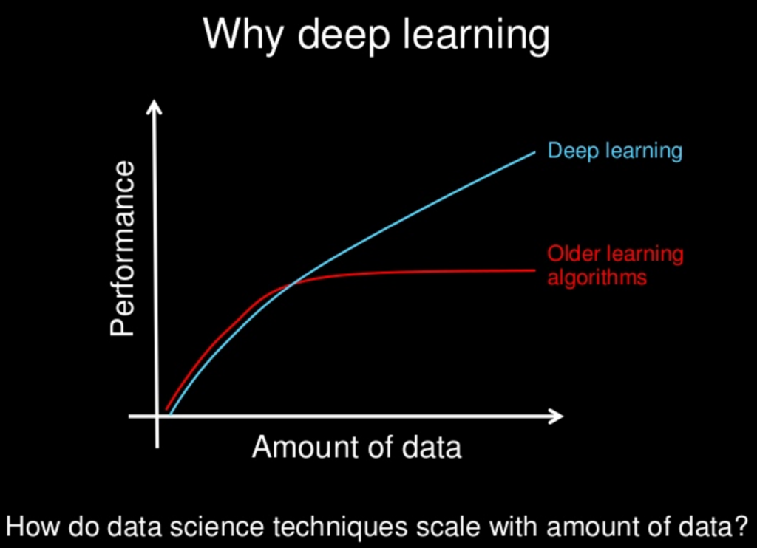

Slide 6
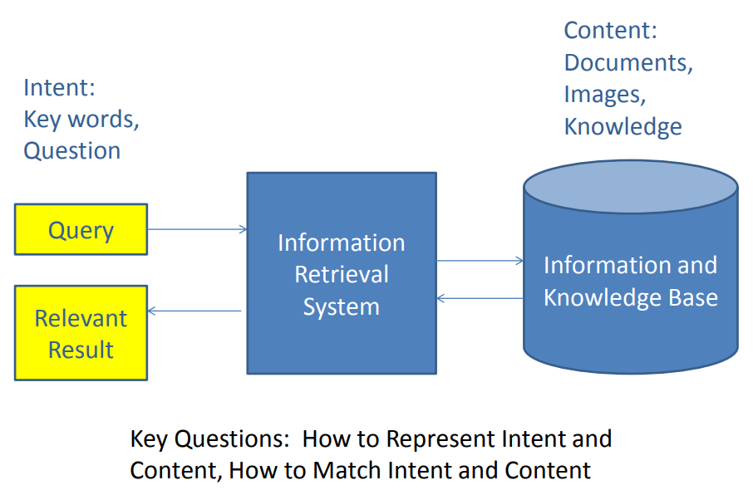
IR background

Slide 7
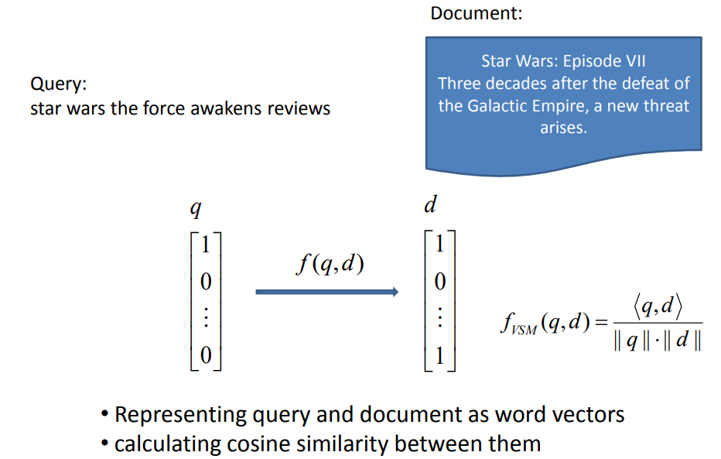
Traditional IR – Tfidf example

Slide 8
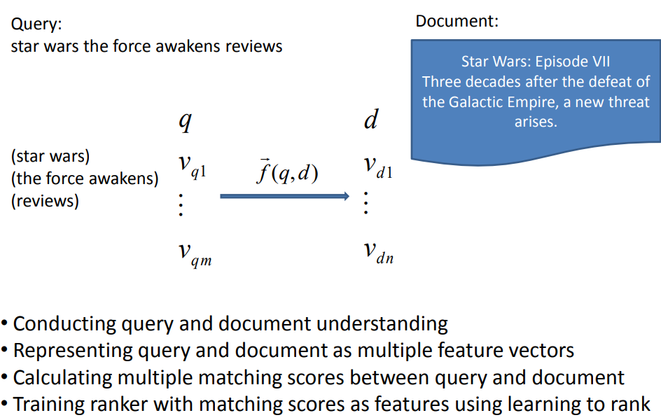
Modern IR – Learn to Rank

Slide 9
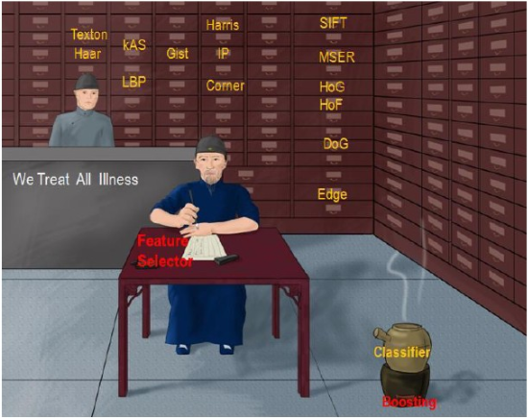
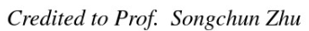
Features + Ranking
Features：
Language model
BM25
Title/Snippet/Document
Pagerank
Ranking:
Point-wise
Pair-wise
List-wise

Slide 10
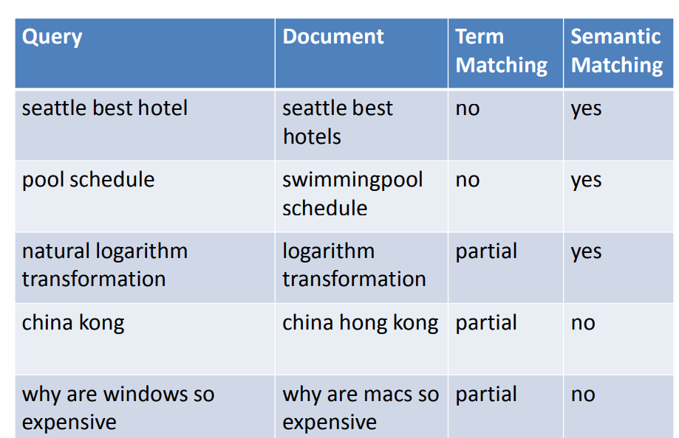
Example of Mismatch
Hang li, http://www.hangli-hl.com/uploads/3/4/4/6/34465961/tsinghua_opportunities_and_challenges_in_deep_learning_for_information_retrieval.pdf

Slide 11
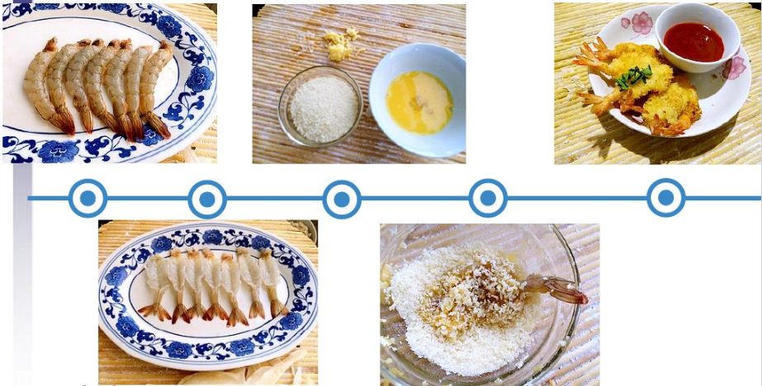
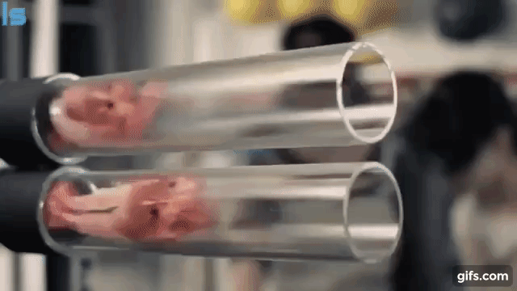
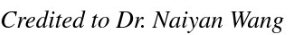
End-to-end
https://www.youtube.com/watch?v=TYpBJ71VW9g
The inputting features are also learnable/trainable

Slide 12
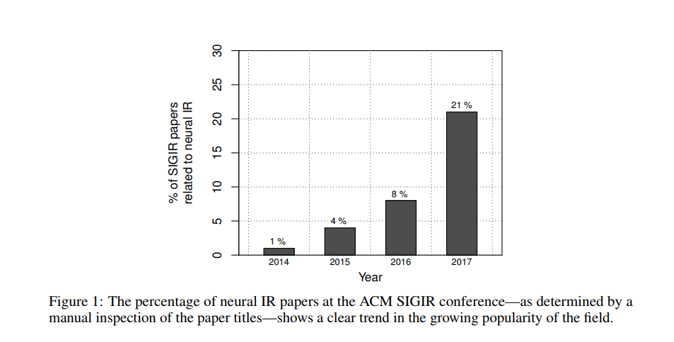
Trends for Neural IR
Mitra B, Craswell N. Neural Models for Information Retrieval[J]. arXiv preprint arXiv:1705.01509, 2017.

Slide 13
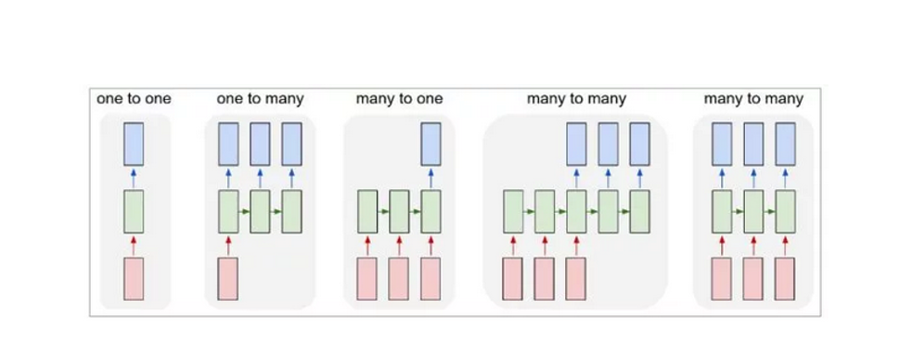

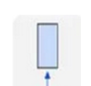
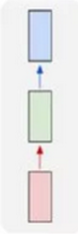
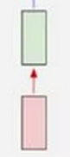
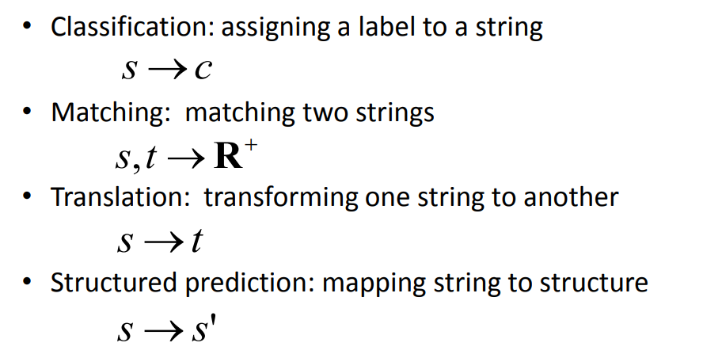
Tasks in IR/NLP
Credited by Hang li

Slide 14
Fundamental Demo In Code with PyTorch pseudo code
Model = LSTM/CNN/Capsule/…
text,lable = Dataset.nextBatch()
representation = Model(text)
Classification = FC(representation) FC : Mapping to label size
Translation = Decode(representation)
Matching = Cosine(representation1, representation2)
Sequential_labelling = FCs(representations )

Slide 15
Background of Neural IR
Trends of DL for IR
Word embedding
Neural network
DL for IR/NLP

Slide 16
Localist representation
Size color … unknown
[.3, .7, .2, .1, .5]
[.5, .3, .2, .1, .0]
[.2, .0, .31, .03, .01]
[.1, .1, .5, .5, 0.2]
BMW [1, 0, 0, 0, 0]
Audi [0, 0, 0, 1, 0]
Benz [0, 0, 1, 0, 0]
Polo [0, 0, 0, 1, 0]
http://www.cs.toronto.edu/~bonner/courses/2014s/csc321/lectures/lec5.pdf

Slide 17
Distributed representation
Size color … unknown
[.3, .7, .2, .1, .5]
[.5, .3, .2, .1, .0]
[.2, .0, .31, .03, .01]
[.1, .1, .5, .5, 0.2]
BMW [1, 0, 0, 0, 0]
Audi [0, 0, 0, 1, 0]
Benz [0, 0, 1, 0, 0]
Polo [0, 0, 0, 1, 0]

Slide 18
Embedding
Distributional hypothesis
linguistic items with similar distributions have similar meanings
imaginary
Complex
Real
Life is complex. It has both real and imaginary parts
https://en.wikipedia.org/wiki/Distributional_semantics

Slide 19
How to get Distributed representation
Matrix Factorization
Word-word Matrix
Document-word Matrix
PLSA
LDA
Sample-based Prediction
NNLM
C & W
Word2vec
Glove is a combination between these two schools of approaches
Levy, Omer, and Yoav Goldberg. "Neural word embedding as implicit matrix factorization." Advances in neural information processing systems. 2014.

Slide 20
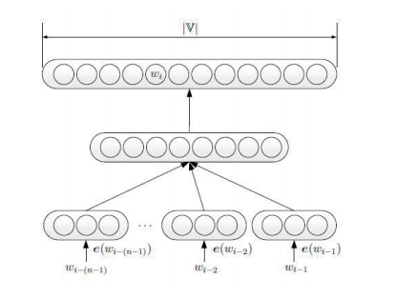
NNLM to Word2vec
Negative sampling
Hierarchical softmax
Concat -> mean
Bengio Y, Ducharme R, Vincent P, et al. A neural probabilistic language model[J]. Journal of machine learning research, 2003, 3(Feb): 1137-1155.
Mikolov T, Chen K, Corrado G, et al. Efficient estimation of word representations in vector space[J]. arXiv preprint arXiv:1301.3781, 2013.

Slide 21
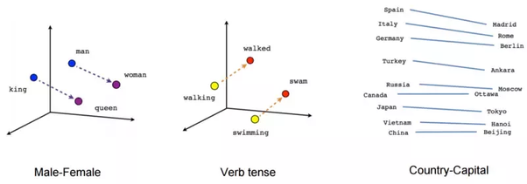
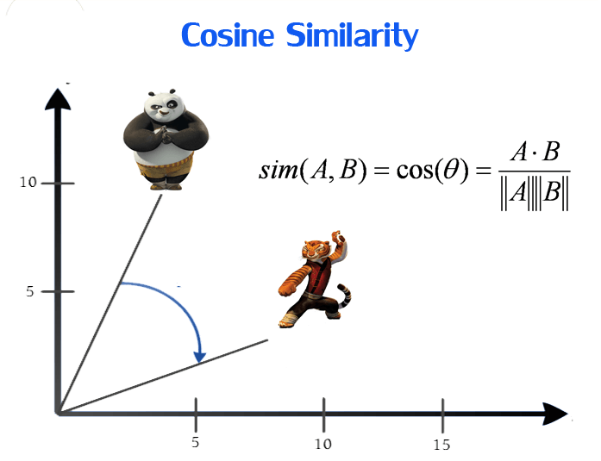
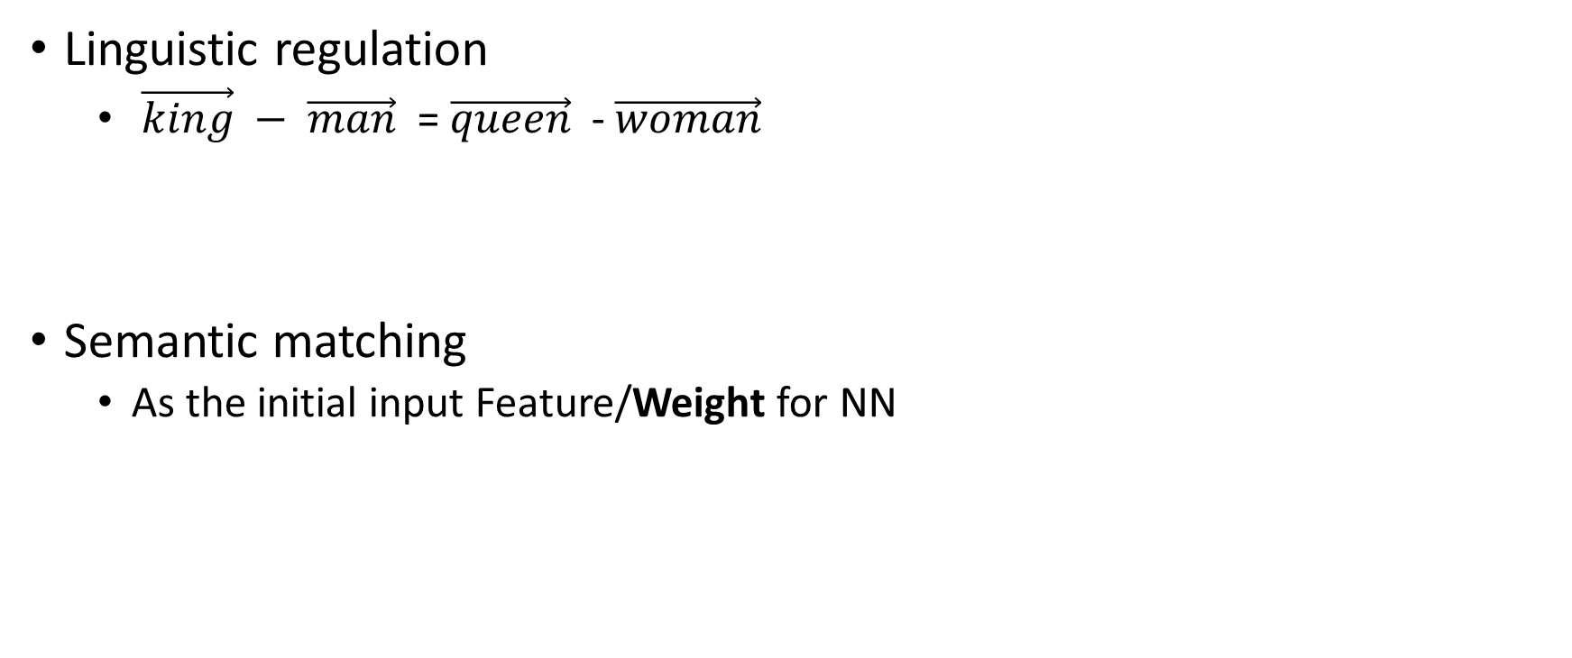
Advantage of word embedding
Linguistic regulation
$\vec{king} − \vec{man}$ = $\vec{queen}$ - $\vec{woman}$
Semantic matching
As the initial input Feature/Weight for NN

Slide 22
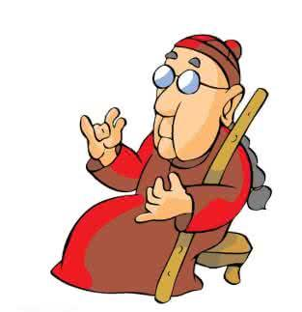
Only Word Embedding ?
Which is the most similar word of “Italy” ?
Maybe “Germany” or “Pasta” ?
You cannot guarantee that each similar word pair could help your matching ?
Nie Jianyun said in SIGIR 2016 Chinese-Author Workshop, Tsinghua University, Beijing

Slide 23
Background of Neural IR
Trends of DL for IR
Word embedding
Neural network
DL for IR/NLP

Slide 24
Neural Network
MLP
CNN
Shift/Space invariant
Recurrent NN - [LSTM/GUR]
Time-sensitive
Recursive NN
Structure-sensitive
Special Case
Seq2seq
GAN
Reinforced Learning

Slide 25
MLP

Slide 26

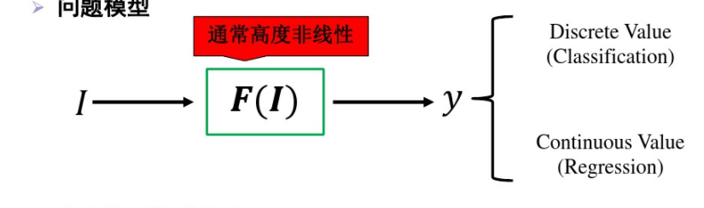
UAT in MLP
Multi-layer Non-linear Mapping - > Universal Approximation Theorem

Slide 27
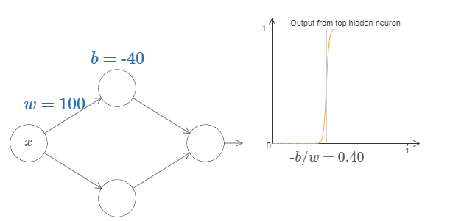
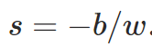
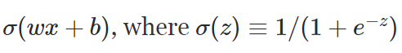
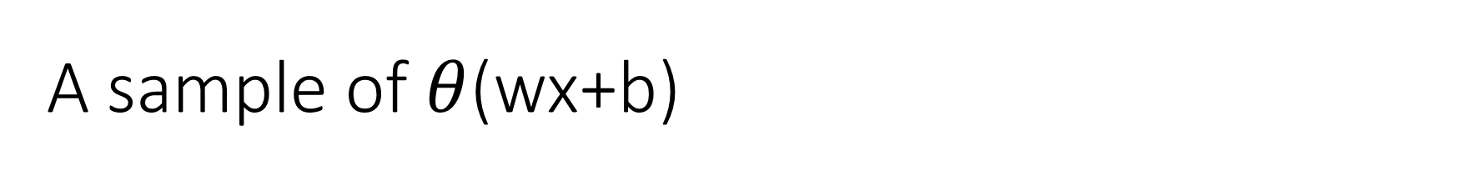
A sample of $θ$(wx+b)
http://neuralnetworksanddeeplearning.com/chap4.html

Slide 28
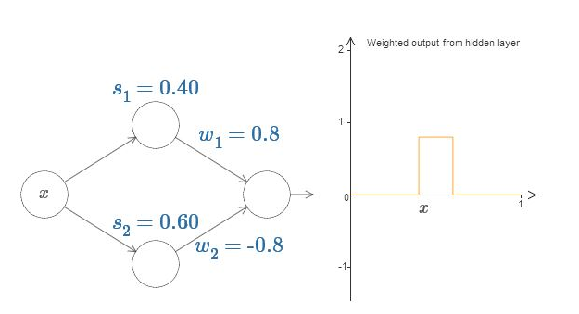
An another sample

Slide 29
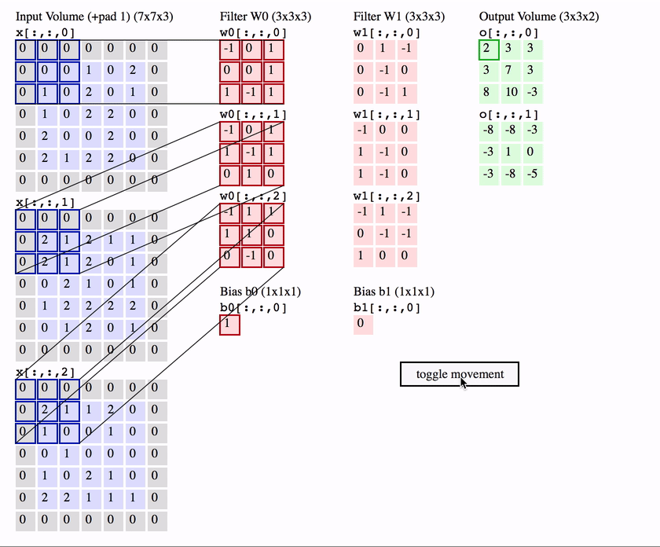
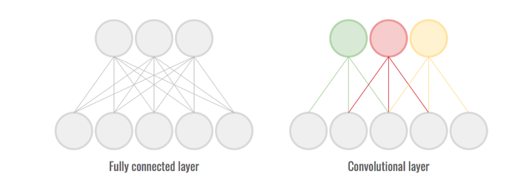
From MLP to CNN
Local connection
Shared weight
Pooling strategy

Slide 30
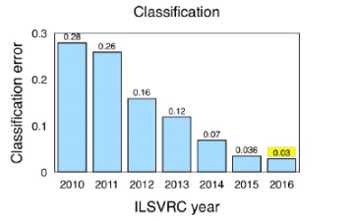
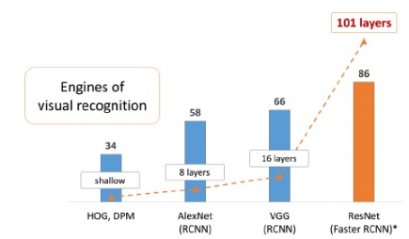
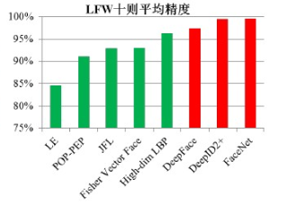
Deep NN in CV
Top 5 error in ImageNet classification
10-fold mean precision Face recognition LFW dataset
MAP in Pascal VOC visual recognition
Deep NN

Slide 31
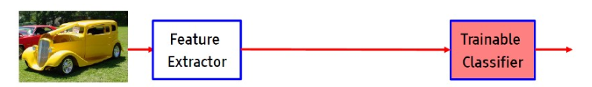
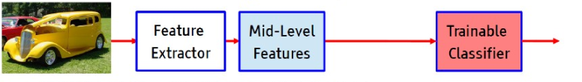
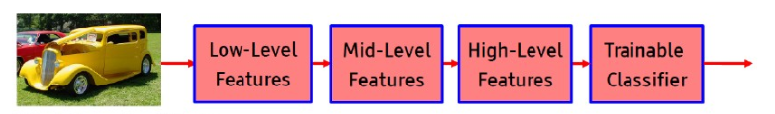
End-2-end in CV
Tradition CV
Modern CV： Unsupervised mid-representation
DNN CV ： end-2-end

Slide 32
CNN
Basic CNN
Kalchbrenner N, Grefenstette E, Blunsom P. A convolutional neural network for modelling sentences[J]. arXiv preprint arXiv:1404.2188, 2014
Kim CNN
VDCNN

Slide 33
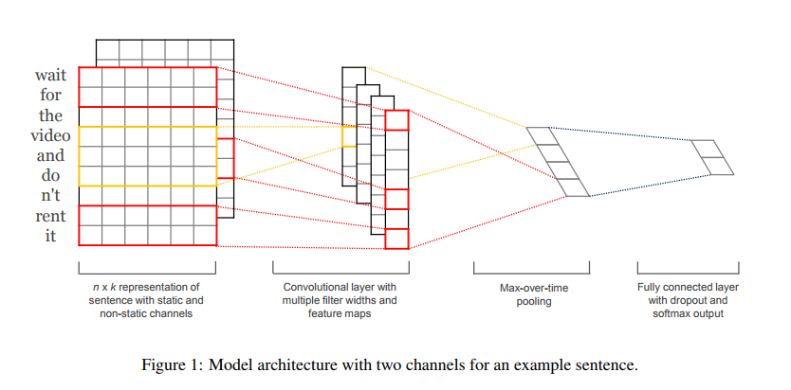
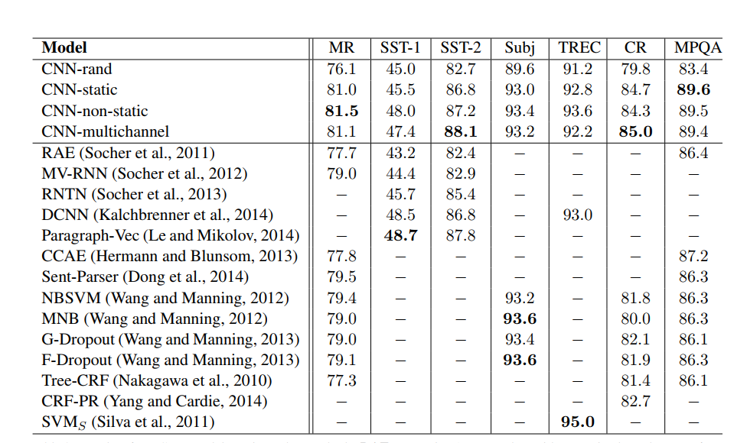
CNN [kim EMNLP 2014]

Slide 34
Go deeper or not?
DEEP
Slower
Overfitting
More Parameters, more data need to feed
Hard for convergence
Highway network
Residual Block
Inception
Shallow: one-layer
Fast
Less data, es. Fastext.

Slide 35
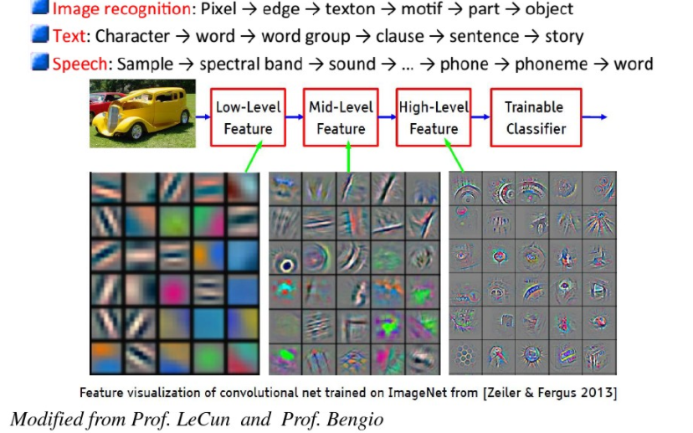
Go deeper or not?

Slide 36
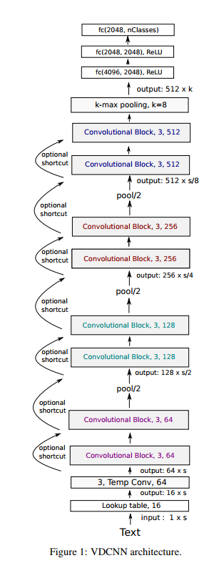
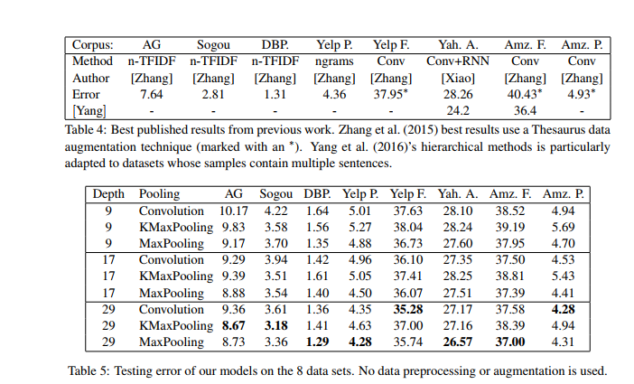
Very Large CNN [Conneau EACL ]

Slide 37
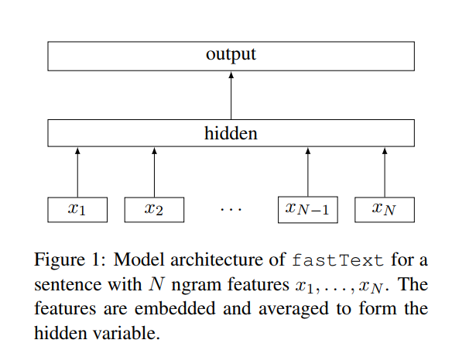
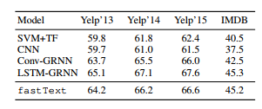
FASTEX [EACL 2017]

Slide 38


RNN

Slide 39
RNN

Slide 40

Forget gate

Slide 41

Input gate
replace tanh with softsign (not softmax) activation for prevent overfitting
https://zhuanlan.zhihu.com/p/21952042

Slide 42

Forgotten + input

Slide 43

Output Gate

Slide 44
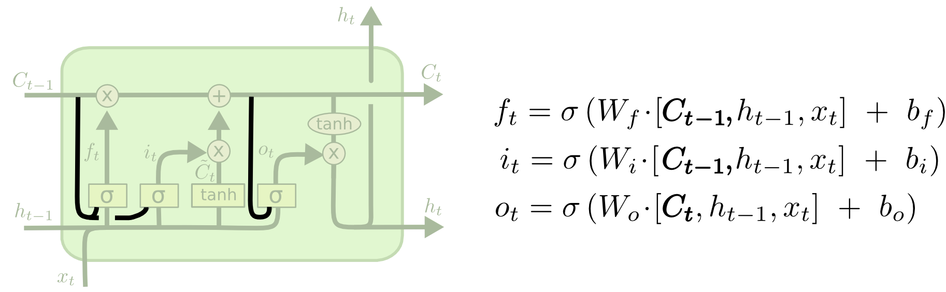
LSTM Variants: Peephole connections

Slide 45
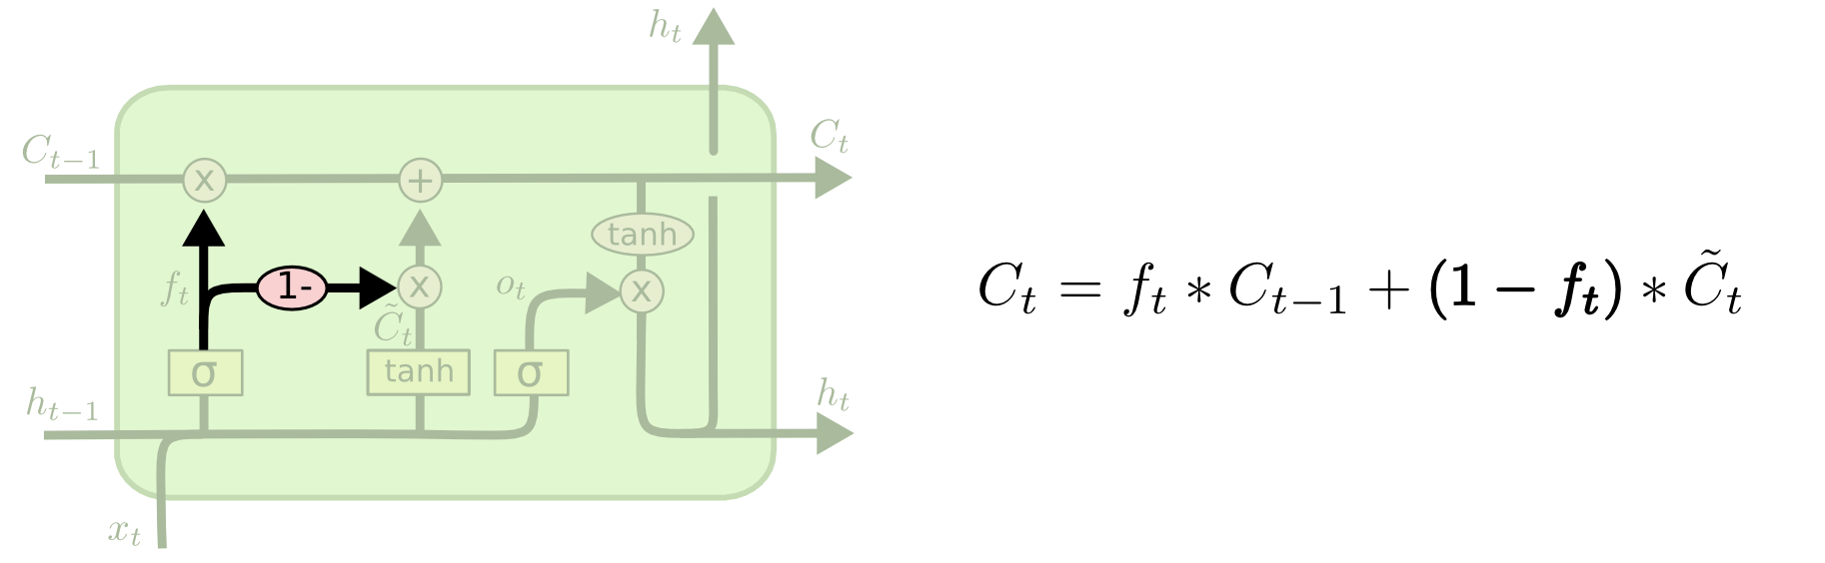
LSTM Variants: coupled forget and input gates

Slide 46

LSTM Variants: GRU
Hidden = Cell
Forget gate + input gate =1

Slide 47
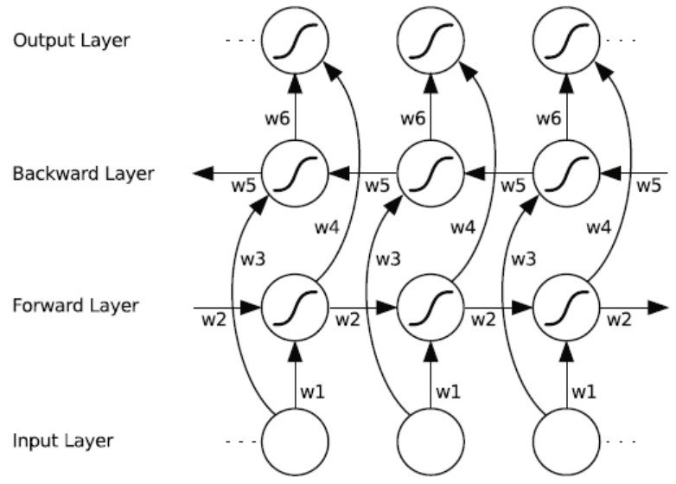
BiLSTM

Slide 48
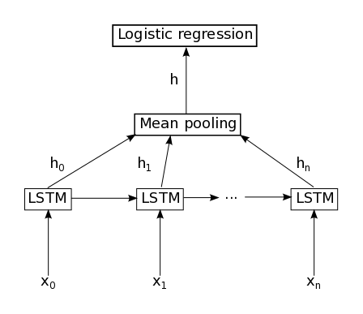
Last or Mean?

Slide 49
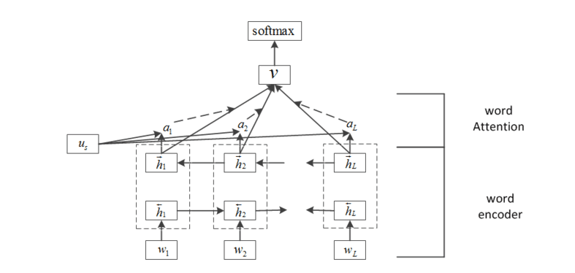

RNN/LSTM with Attention
https://www.jianshu.com/p/4fbc4939509f

Slide 50


Visualization of Attention in RNN/LSTM
Image Caption
Machine Translation

Slide 51


Visualization of Attention in RNN/LSTM
Sematic Entailment
Speech Recognition

Slide 52


Deeper LSTM
Deep is not necessary, but more feeding data!!!

Slide 53
Background of Neural IR
Trends of DL for IR
Word embedding
Neural network
DL for IR/NLP

Slide 54

Seq2seq

Slide 55

State-of-art DL models in NLP
Reading comprehension
536 wiki articles.
10 questions asked by Human

Slide 56

https://rajpurkar.github.io/SQuAD-explorer/

Slide 57

Reinforced learning
Compared to the supervised learning:
You can not know the current reward from the current action, namely a delayed reward,
only in the case that the game is finished.
https://www.kdnuggets.com/2018/03/5-things-reinforcement-learning.html

Slide 58

GAN

